Slide 1
Hotel furniture Offer
20.10.2026

Slide 2
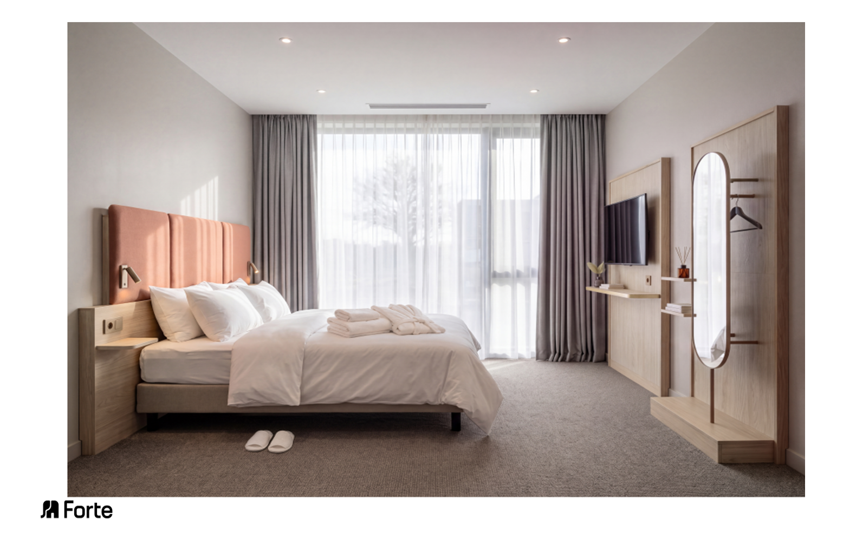

Slide 3
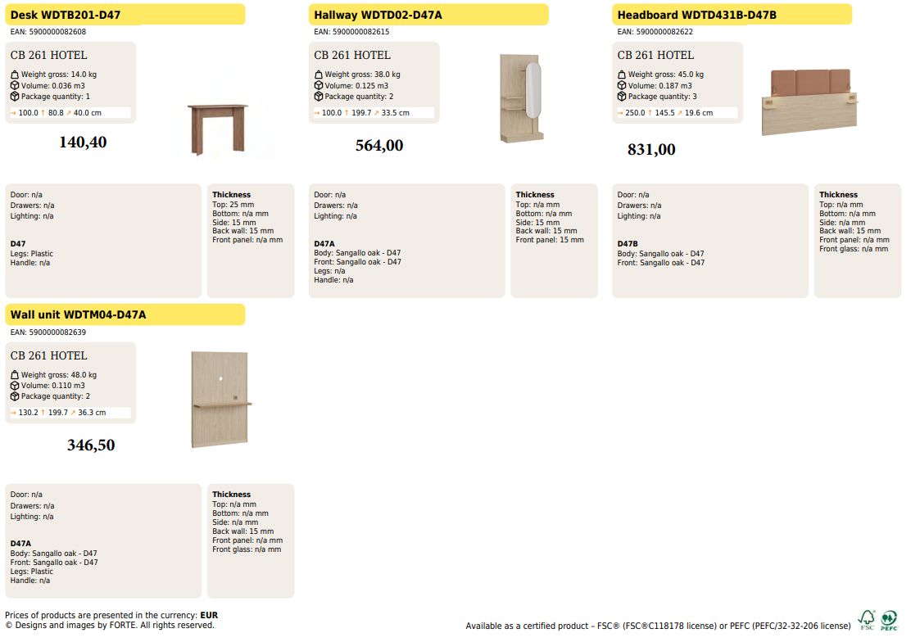

Slide 4
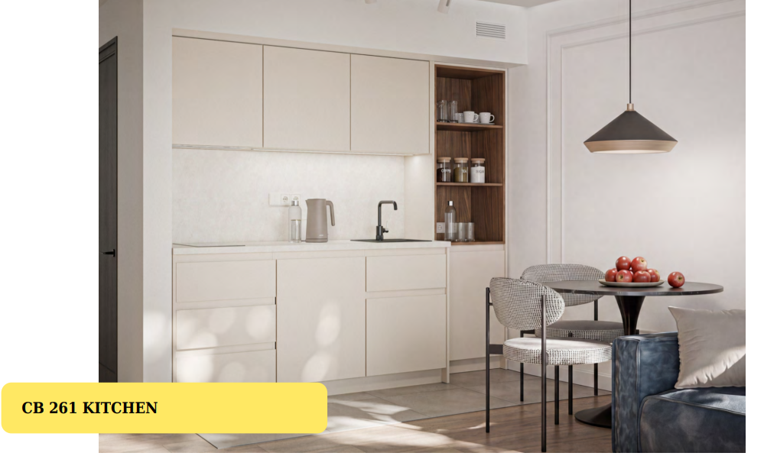

Slide 5
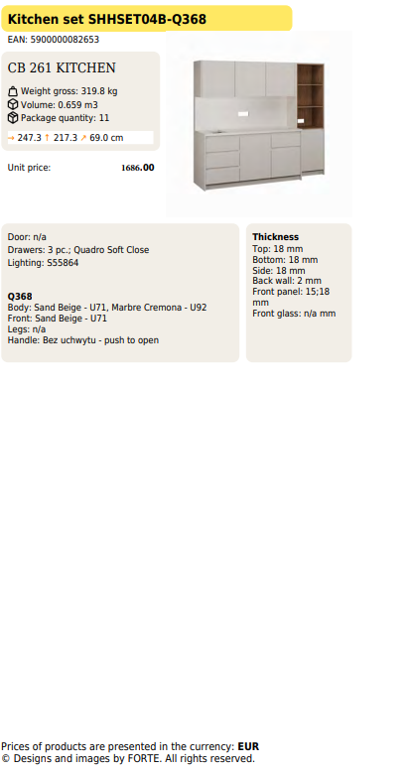

Slide 6
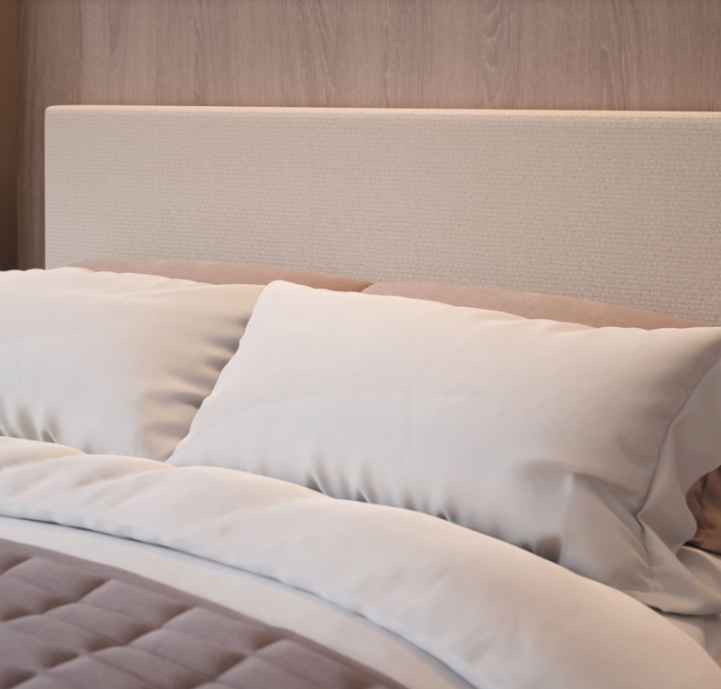
CLASSIC

Slide 7
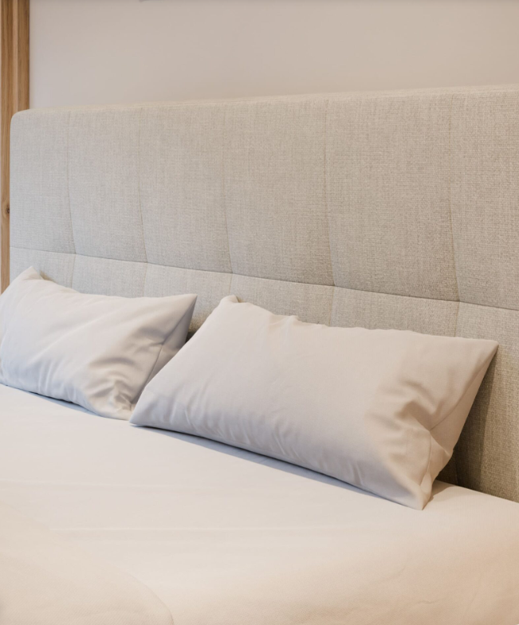
FUTURA

Slide 8
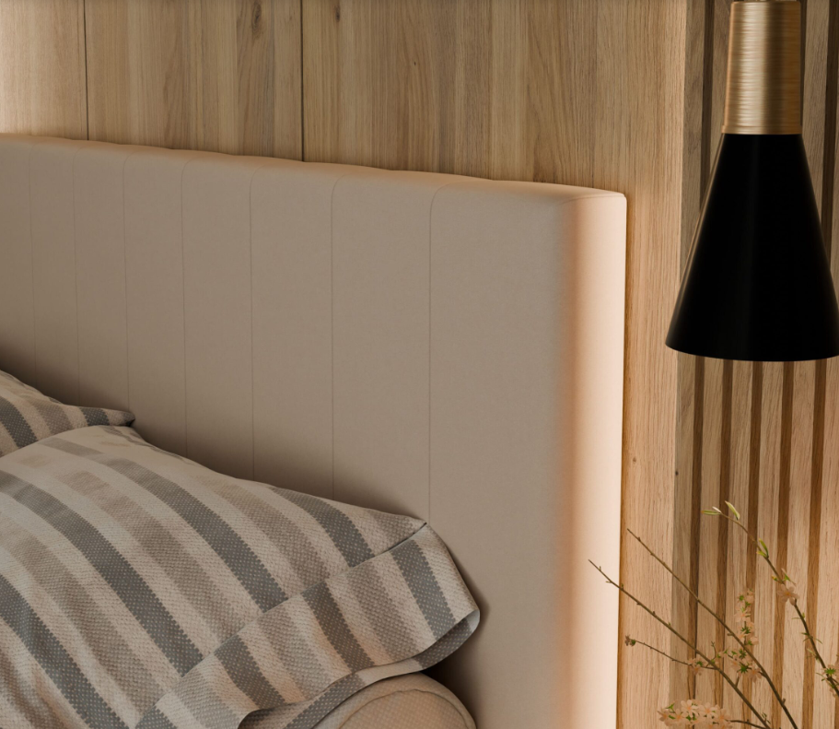
NAOMI

Slide 9
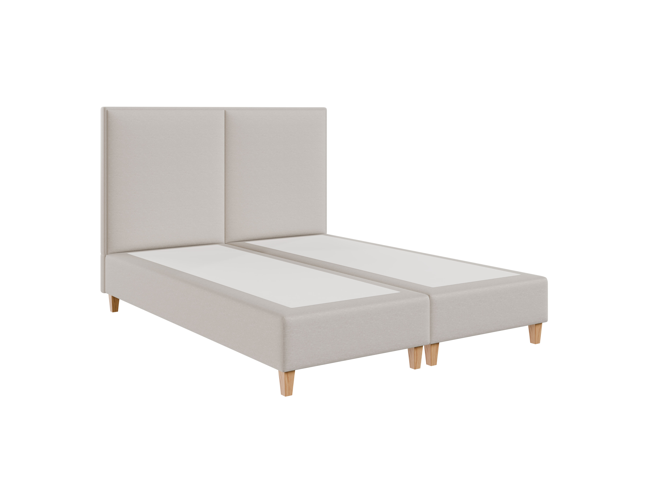
Frame & Headboard
Dimensions | Price EUR
90x200 | 984
120x200 | 1040
140x200 | 1076
160x200 | 1108
180x200 | 1172
200x200 | 1244

Slide 10
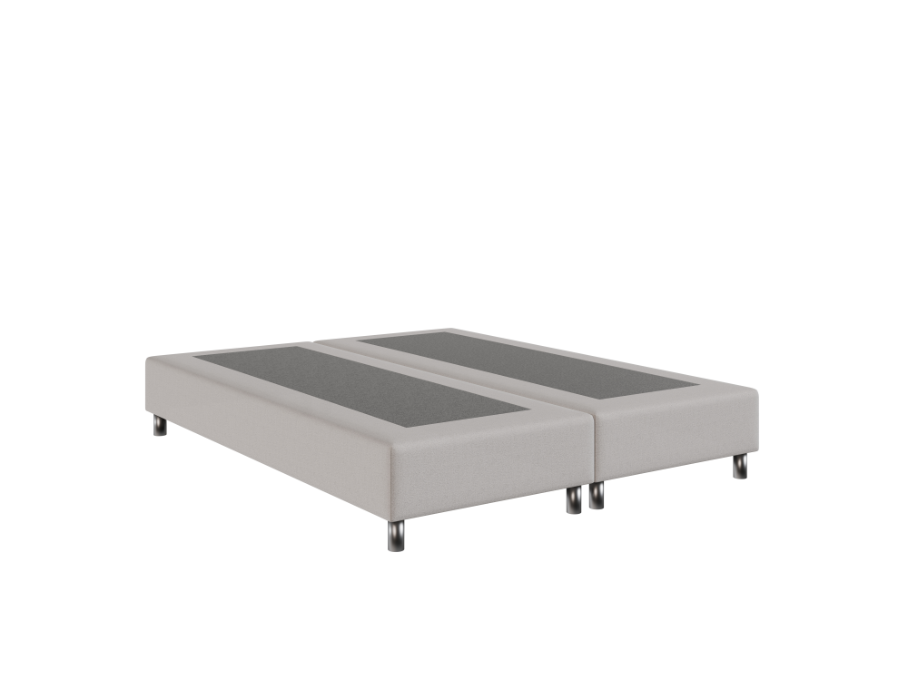
Frame
Boxspring Frame
Dimensions | Price EUR
90x200 | 474
120x200 | 592
140x200 | 724
160x200 | 751
180x200 | 830
200x200 | 927
Boxspring H25

Slide 11
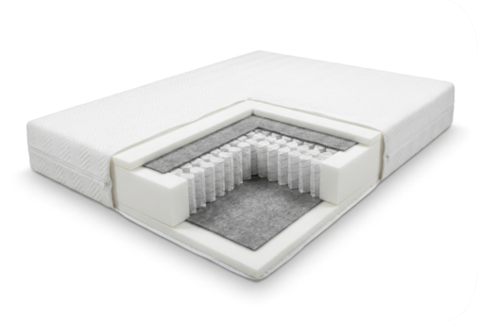
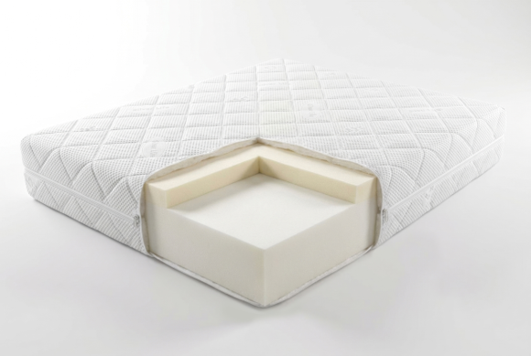
Mattress
Dimensions | Price EUR
90x200 | 278
120x200 | 352
140x200 | 399
160x200 | 447
180x200 | 494
200x200 | 547
Comfort
Dimensions | Price EUR
90x200 | 419
120x200 | 542
140x200 | 625
160x200 | 707
180x200 | 789
200x200 | 871
Taurus

Slide 12
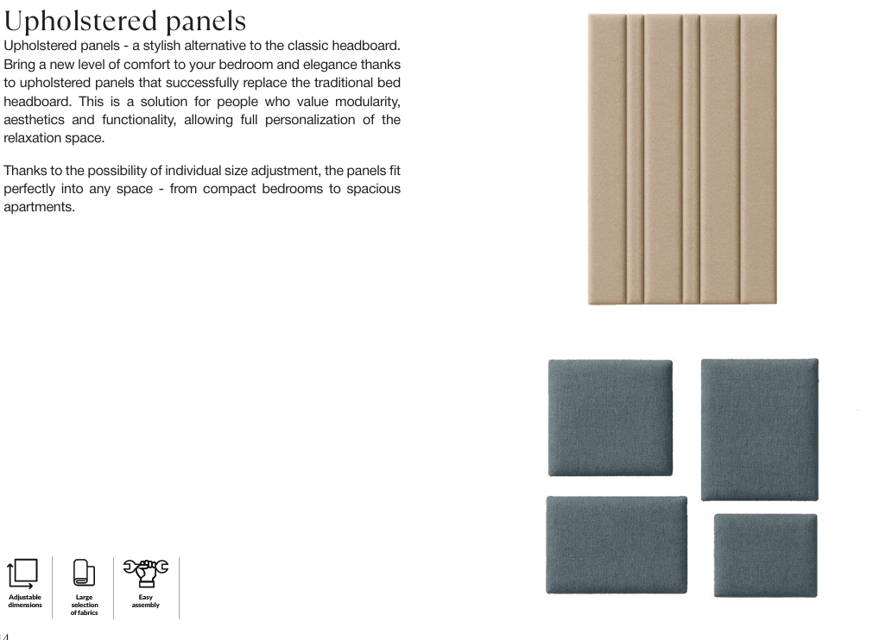

Slide 13
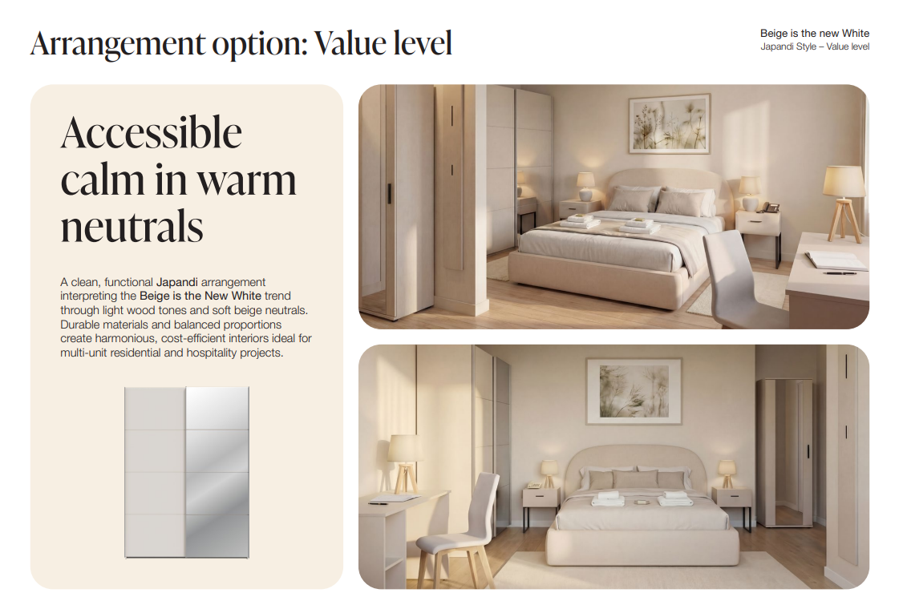

Slide 14
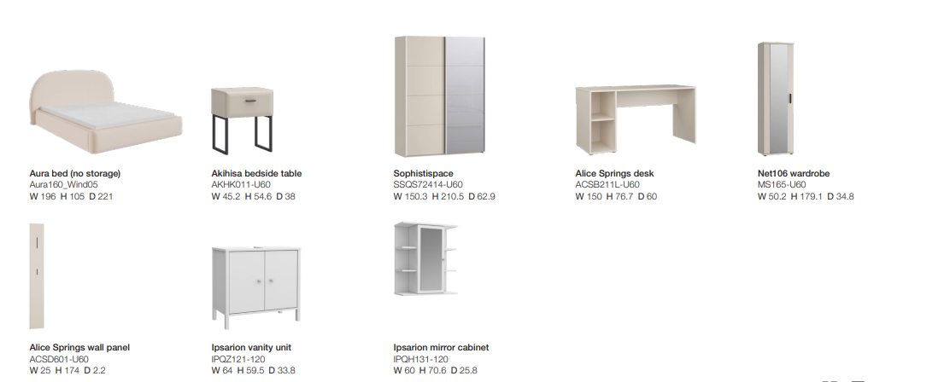

Slide 15
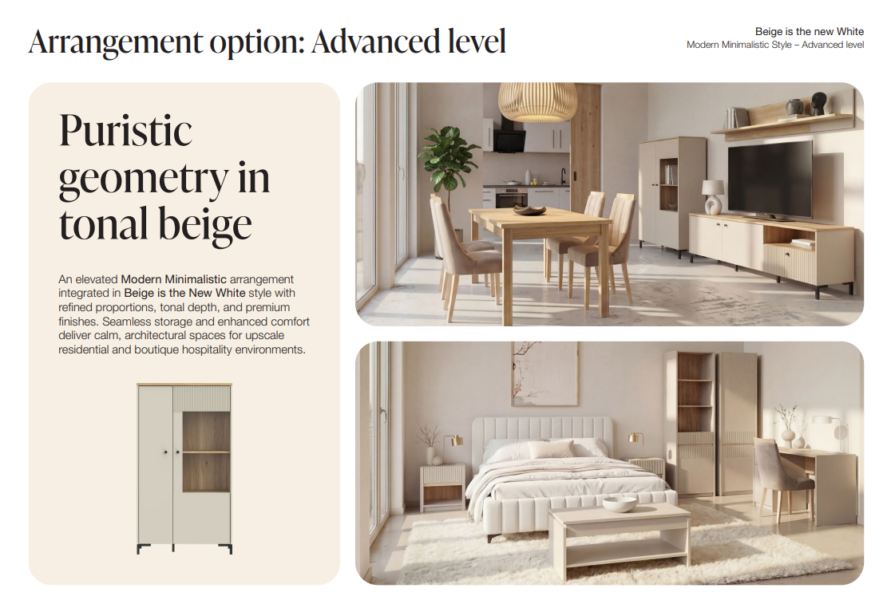

Slide 16
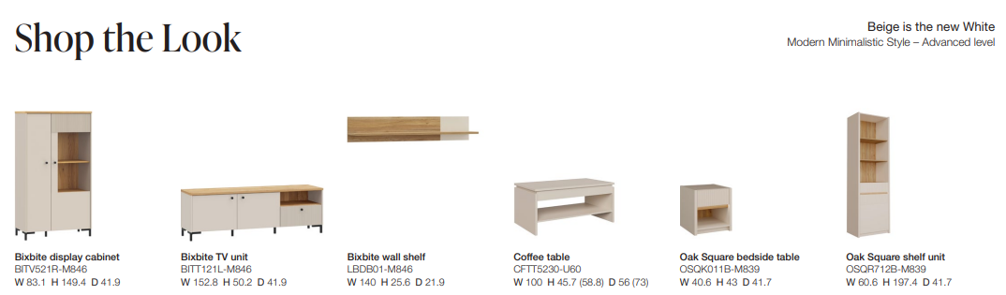
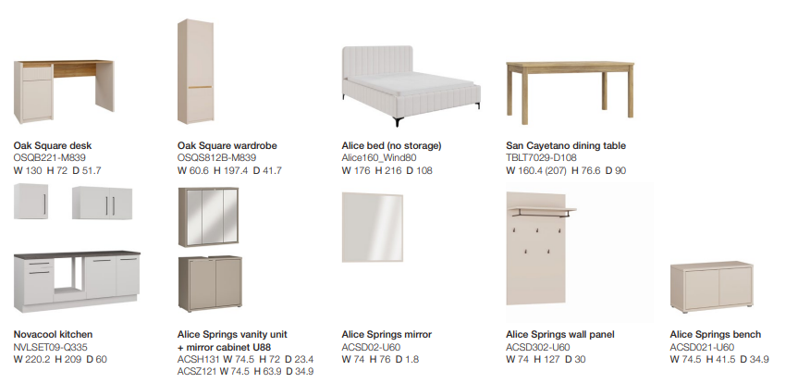

Slide 17
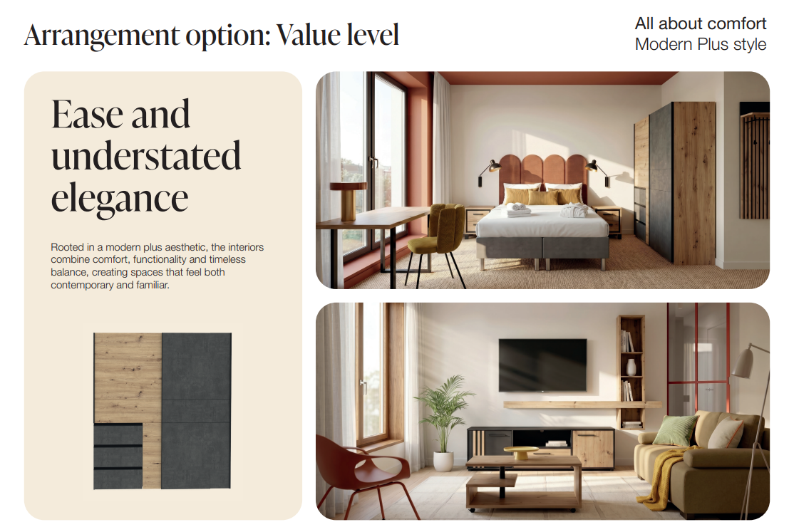

Slide 18
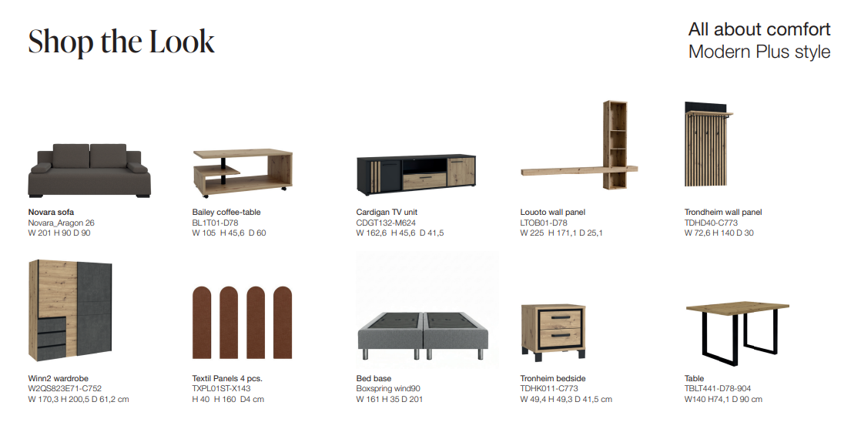

Slide 19
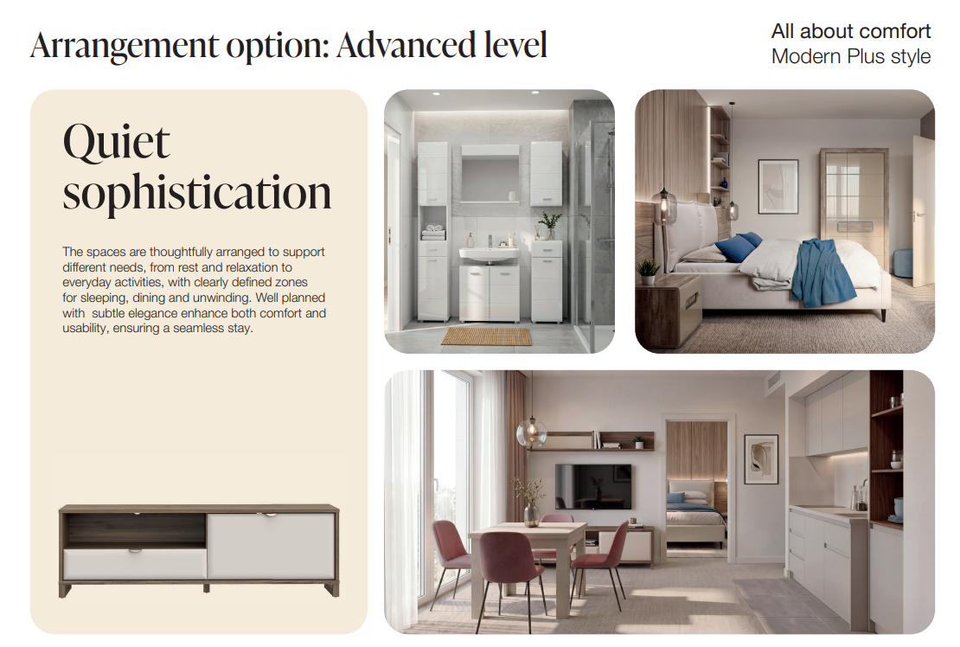

Slide 20
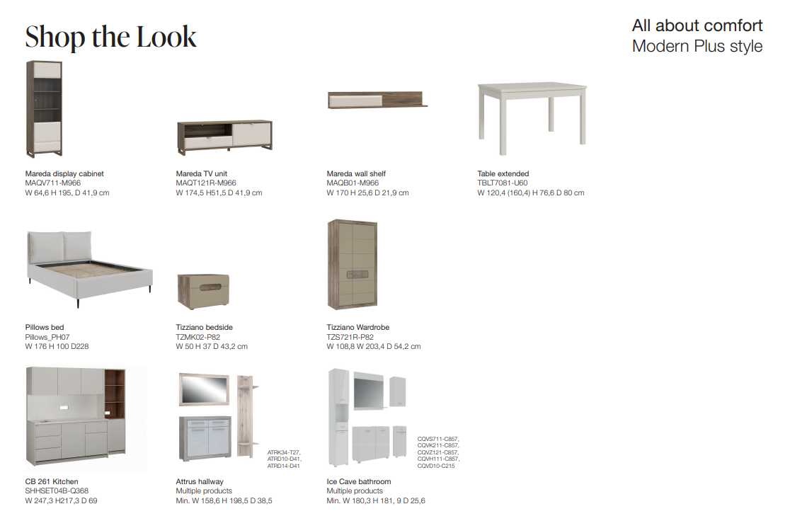

Slide 21
